Slide 1
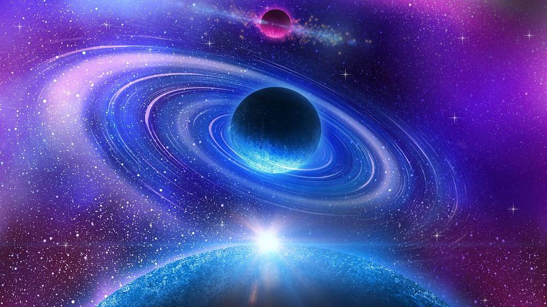
Measurements of the Sky
By: Ci’mone Rogers
Mentor: Timothy Carlton & Rogier Windhorst
School of Earth and Space Exploration

Slide 2
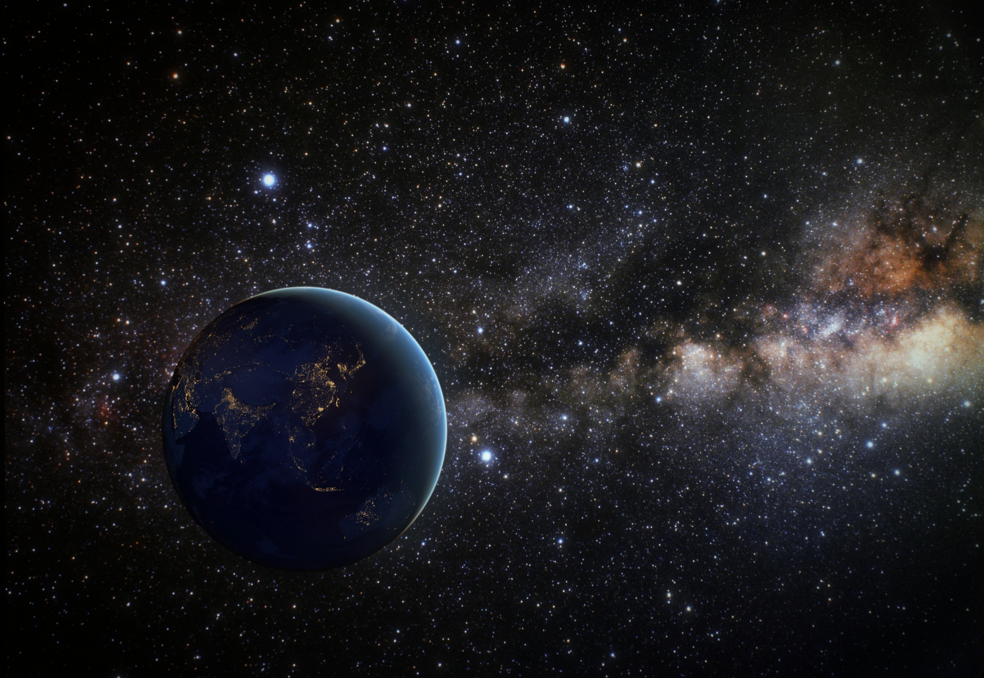
Abstract
More than 95% of all photons in the HST Archive come from <5 AU. Yet, no precise panchromatic all-sky HST measurement of foregrounds exists. ​To better characterize, the foreground project outlined by Skysurf will use coding to measure the light level.
Notes:
We now know of thousands of worlds outside of our solar system, extrasolar planets, that present extreme conditions beyond anything in our solar system. More than 95% of all photons in the HST Archive come from <5 AU. Yet, no precise panchromatic all-sky HST measurement of foregrounds exists. ​To better characterize, the foreground project outlined by Skysurf will use coding to measure the light level. Also, to ensure the different collaboration is not affecting the sky level measurements over time. We found no evidence of the calibrations applied effects the sky measurements. I will touch upon the key questions, current state-of-the-art observations, challenges in their interpretation, and prospects for future characterization efforts of sky measurements from the James Webb Space Telescope.

Slide 3

Goal
Measure the brightness of the light, and how it varies across the sky and how it varies as a function of wavelength.

Slide 4
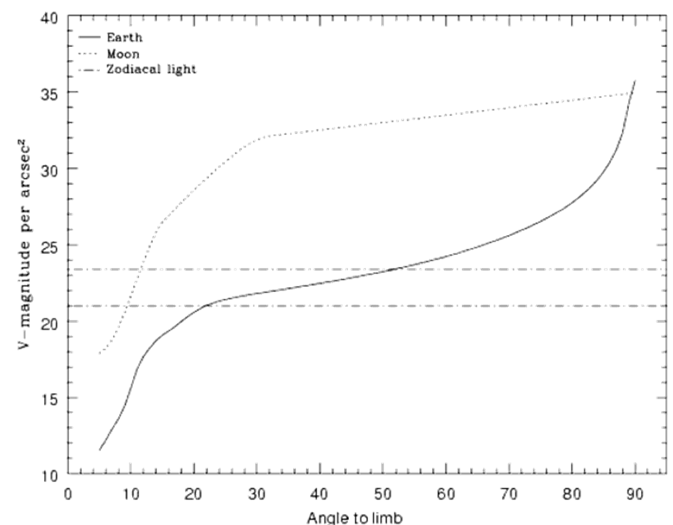
Method
Break up image and sky into sections
Measure sky and standard deviation of the sky
Excluded area with objects by checking the pixels
We take the fifth percentile of the sky measurements
Notes:
The method is careful to ignore any light from the object and focus on the background sky light.

Slide 5
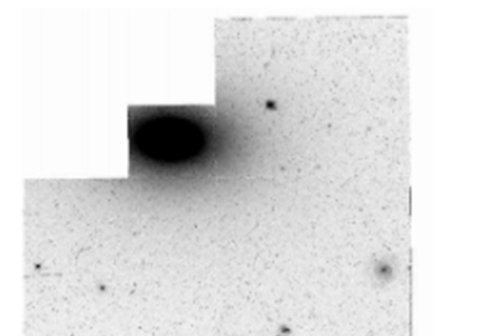
Example of the object we want to avoid
Notes:
Example of the object we want to avoid

Slide 6
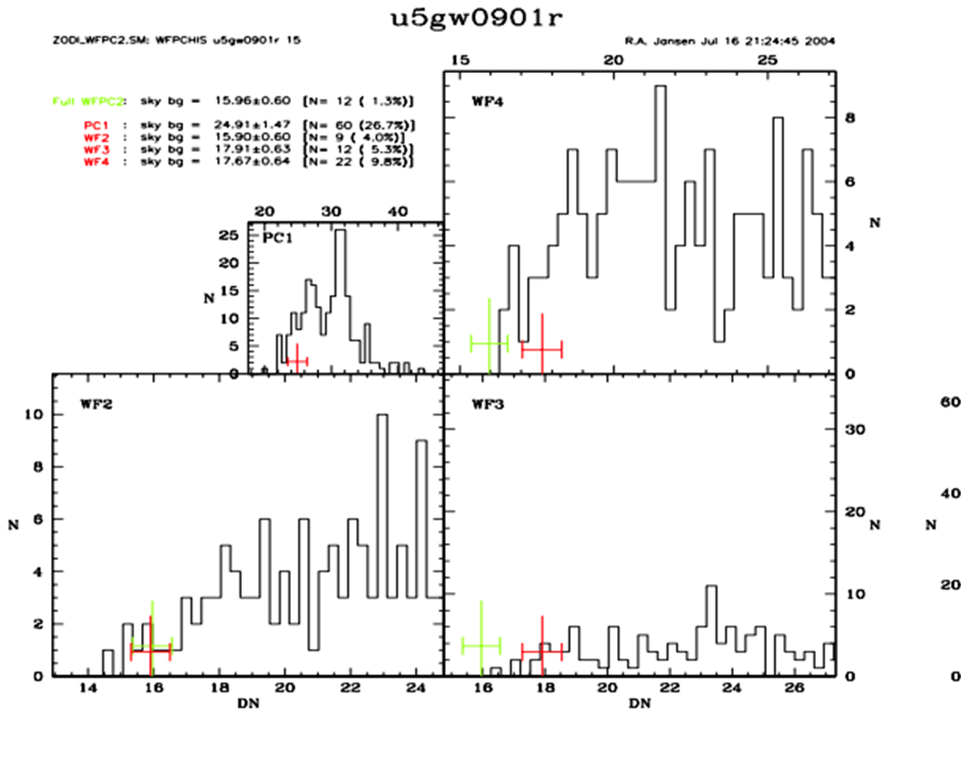
Notes:
X = pixel values
Y = # of pixels
A lot of pixels have wide values = shows a lot of objects

Slide 7
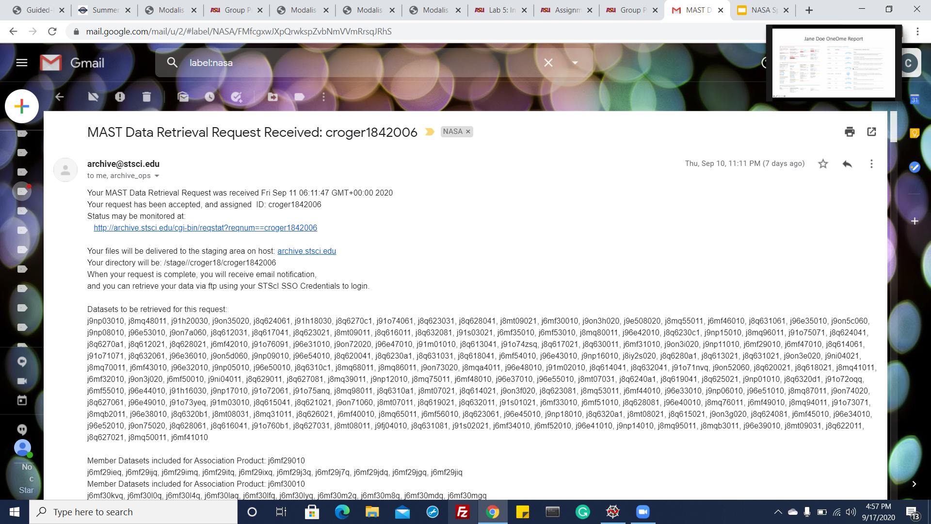

Slide 8
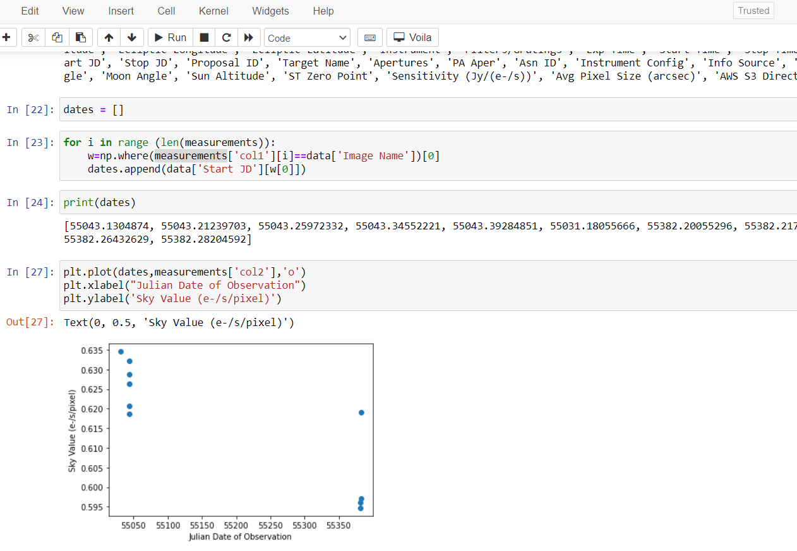

Slide 9
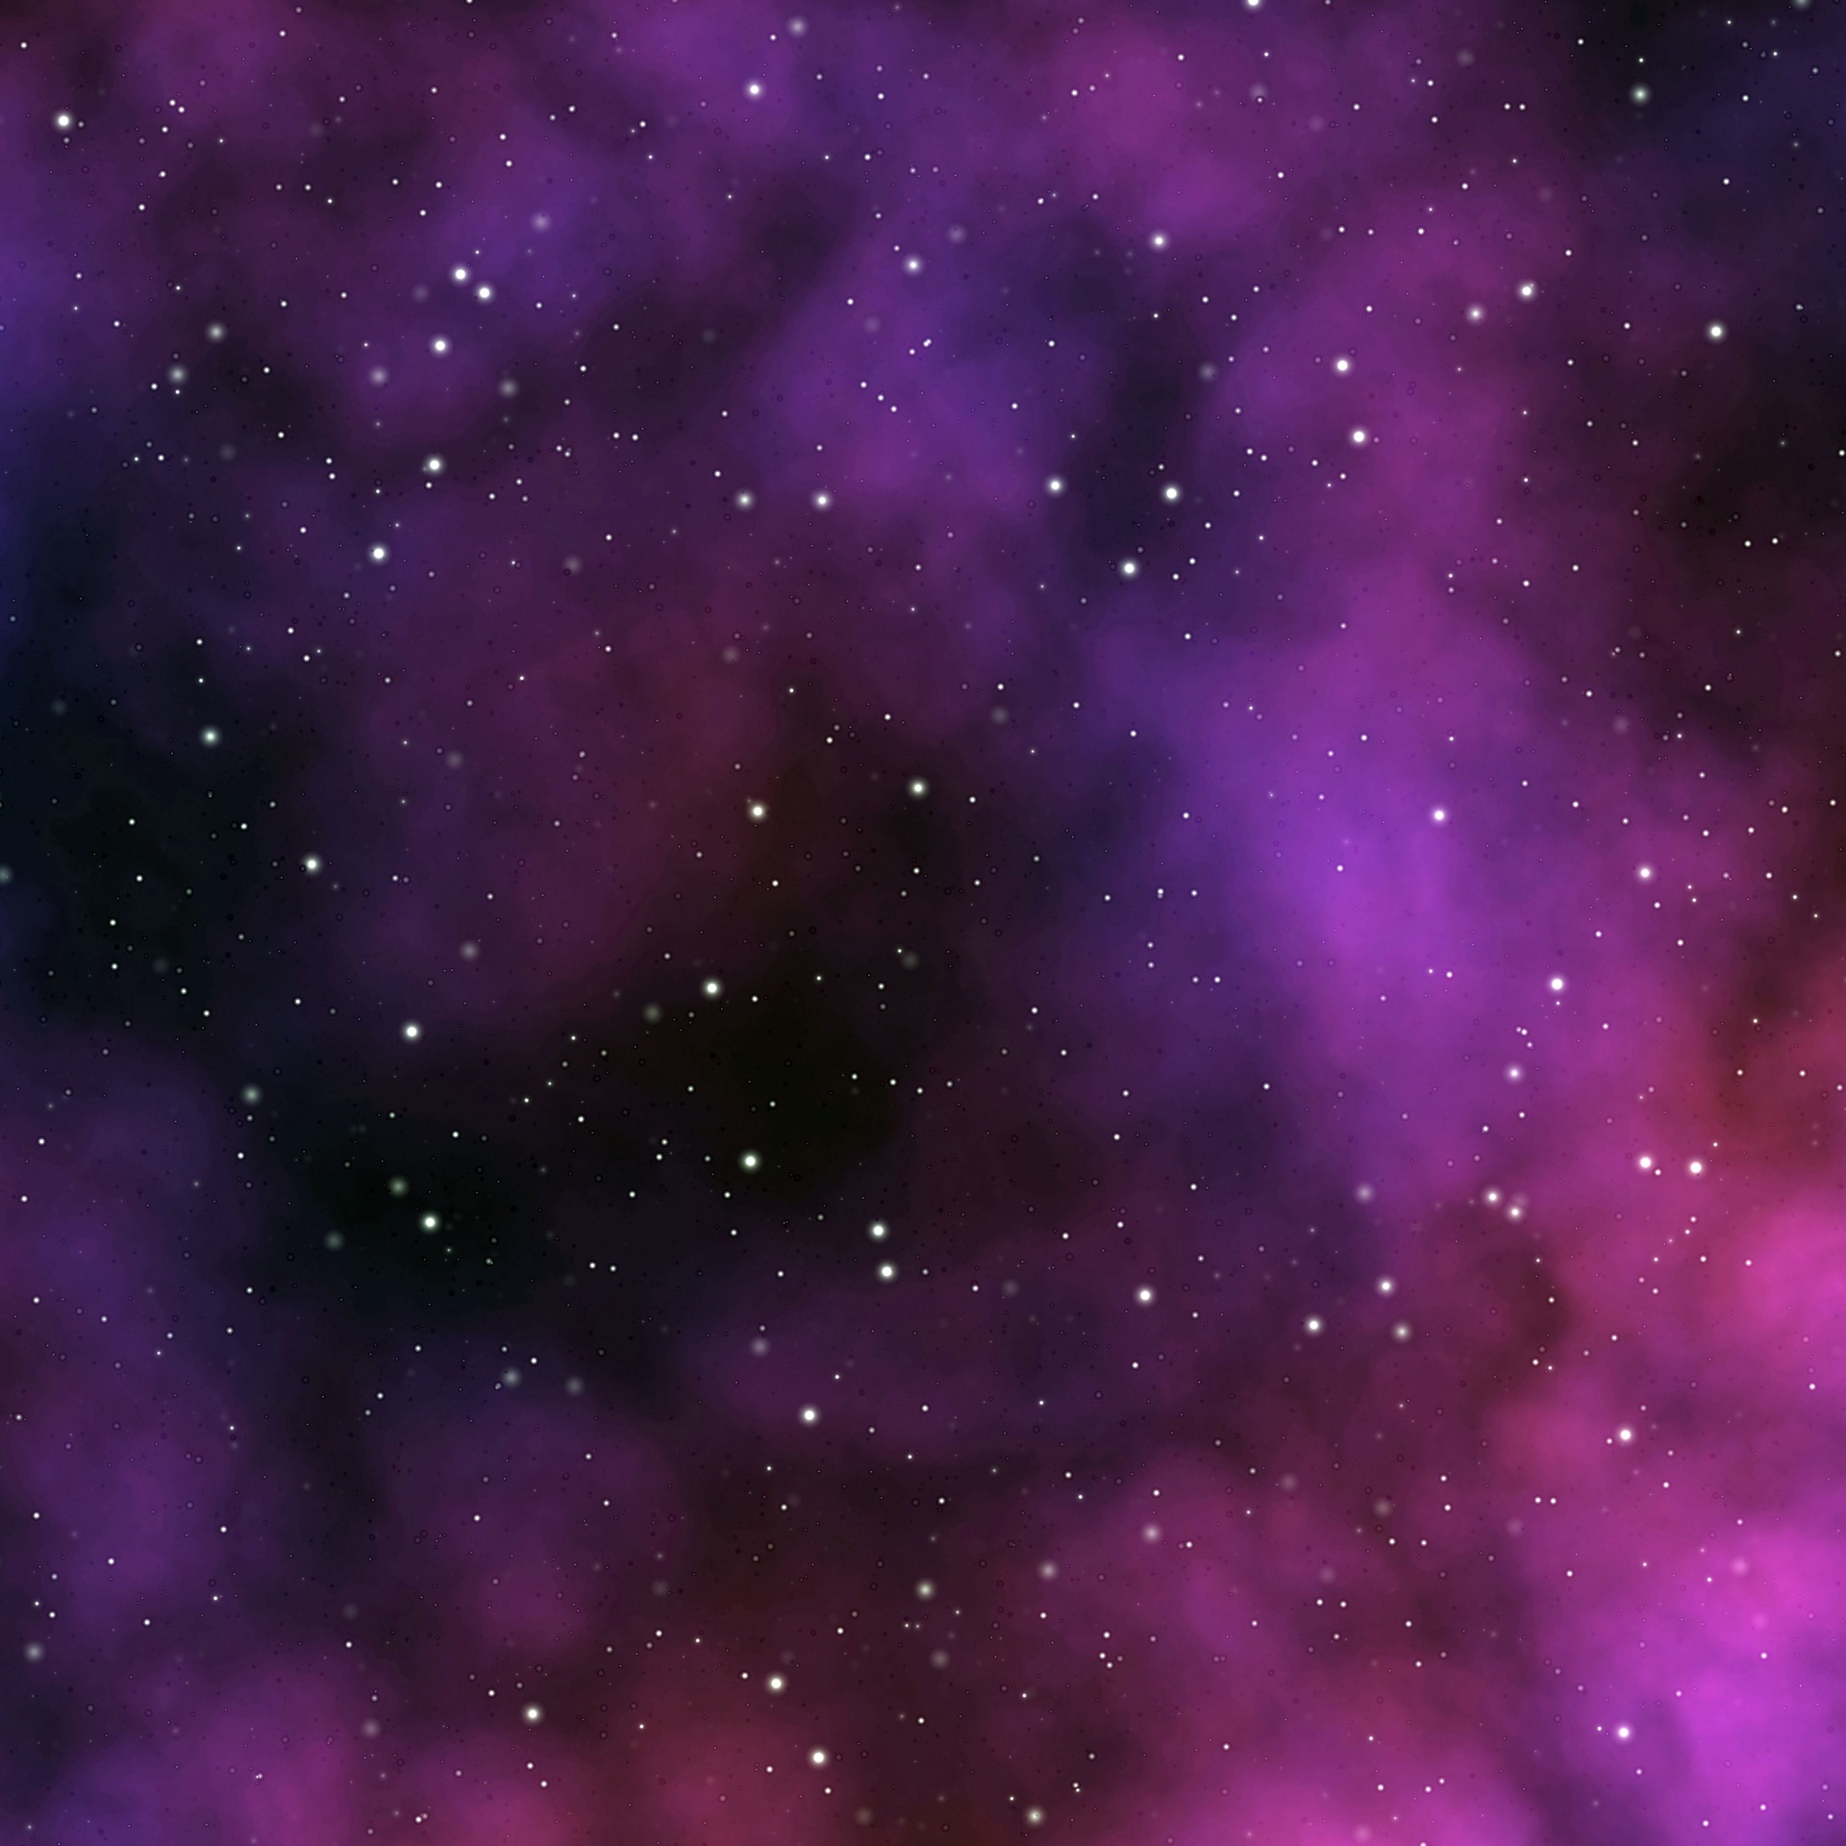
Conclusion
Small limb angles to larger limb angles
Largest limb angle
Least contamination from Earth's light
Notes:
During an orbit, HST may go from small limb angles (left) to larger limb angles (right). We want the sky measurement from the largest limb angle because that has the least contamination from Earth's light

Slide 10
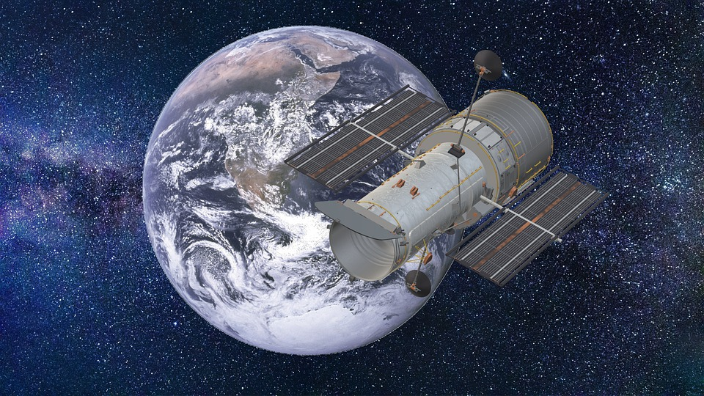
Questions?
ThankYou

